Slide 1
DESIGN INTERACTIVE DASHBOARDS USING TABLEAU
MITIGATING BIRD STRIKE IN AVIATION PROJECT PART-1
MENTOR: MUNNA PANDEY
SUBMITTED BY :
M.PRIYANKA

Slide 2
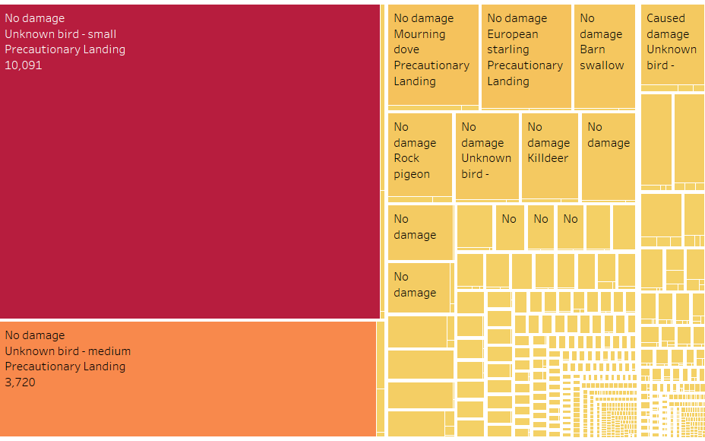
Safety Improvement
What are most common wildlife species involved in bird strikes , and how do they impact flight safety
INTERPRETATION: The Most common wildlife species involved in bird strike is unknown bird small has more bird strikes with 10091 while precautionary landing and there is no damage.

Slide 3
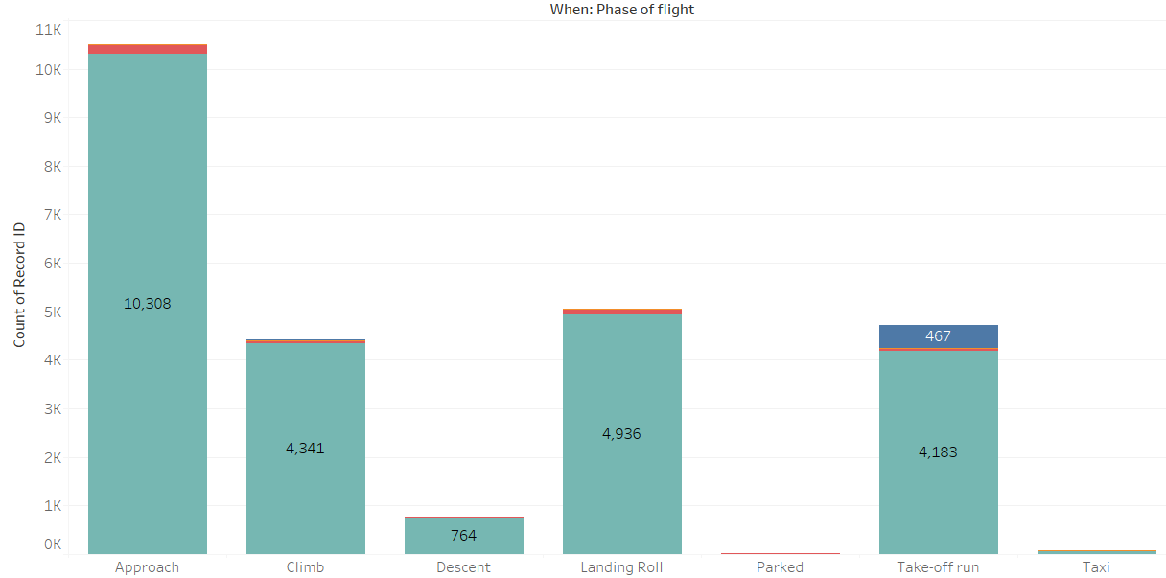
During which phase of flight the wildlife strikes most likely to occur.
Interpretation: From that chart, The approach phase has most wildlife strikes most occurred with 10308.

Slide 4
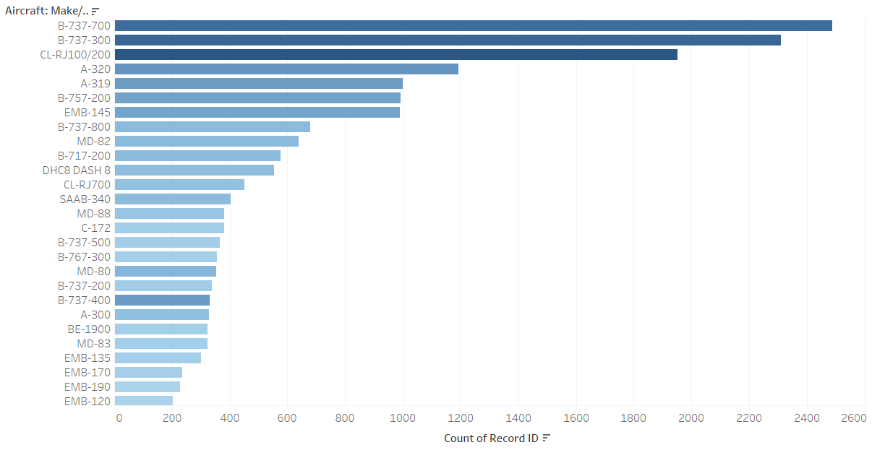
Can we identify Aircraft models or types that are more prone to wildlife strikes
Interpretation: The aircraft model B-737-700 has highest number of wildlife strikes.

Slide 5
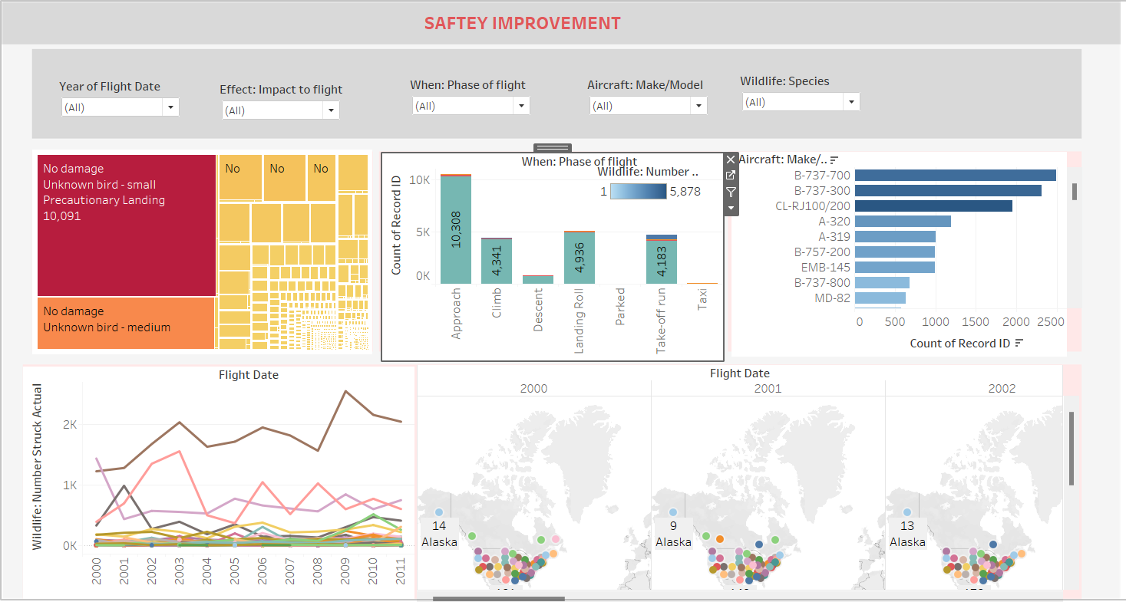
Safety Improvement Dashboard

Slide 6
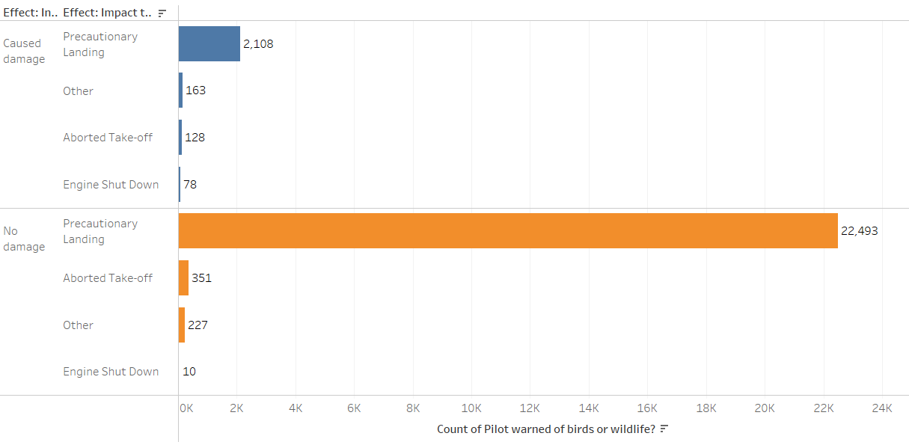
Regulations Compliance
Bird strike incidents reported in compliance with aviation safety regulations
.
Interpretation: The majority bird strike incidents reported in no damage with 22493 incidents in precautionary landing.

Slide 7
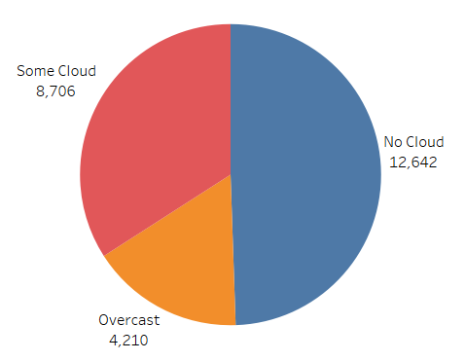
How were the Sky conditions during hits.
Interpretation: The more hits reported during the sky condition of no cloud

Slide 8
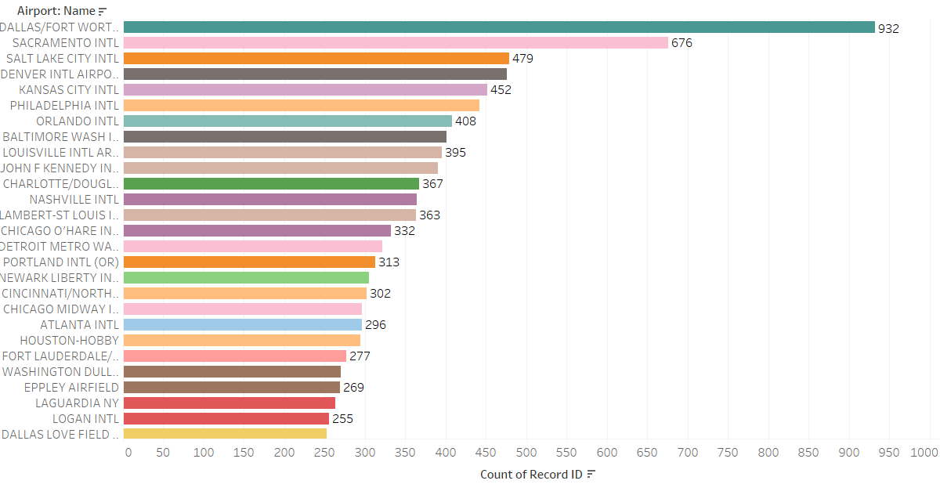
Which airport took highest number of airstrikes
Interpretation: The Dallas airport took highest number of strikes with 932 incidents are reported.

Slide 9
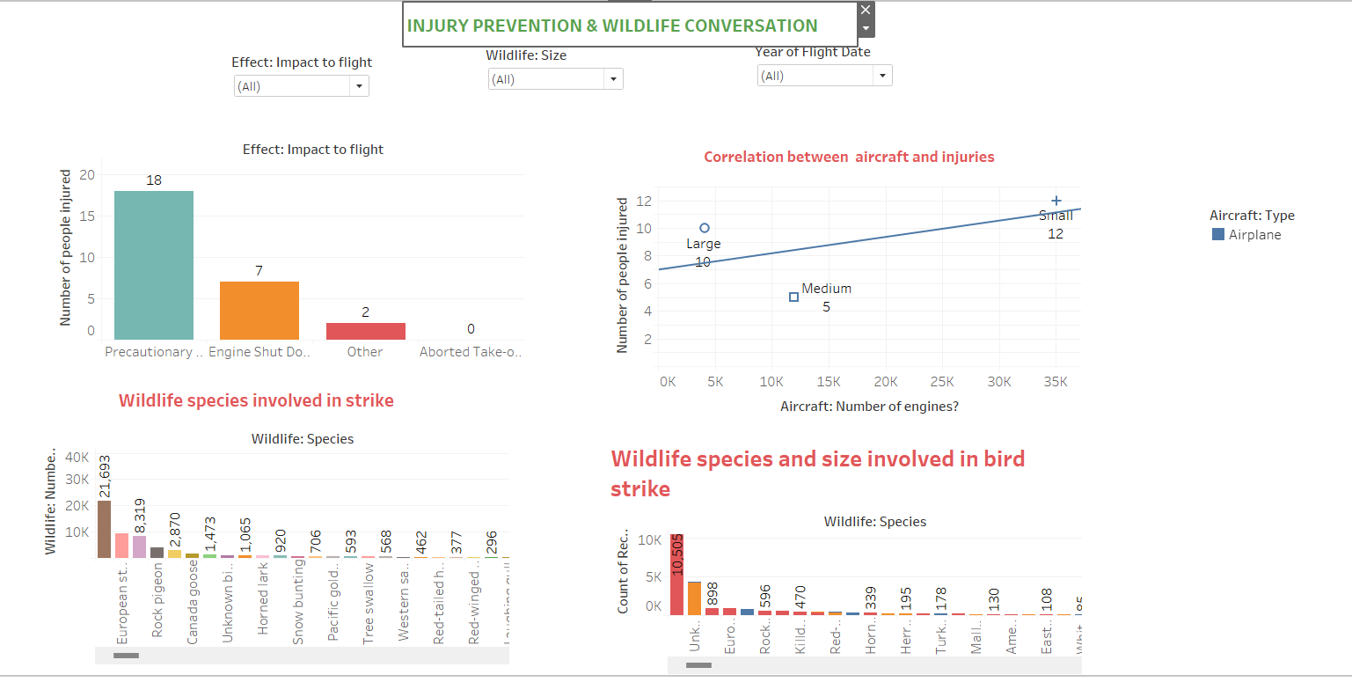
Injury prevention and wildlife conversation Dashboard

Slide 10
MITIGATING BIRD STRIKE IN AVIATION PROJECT PART-1

Slide 11
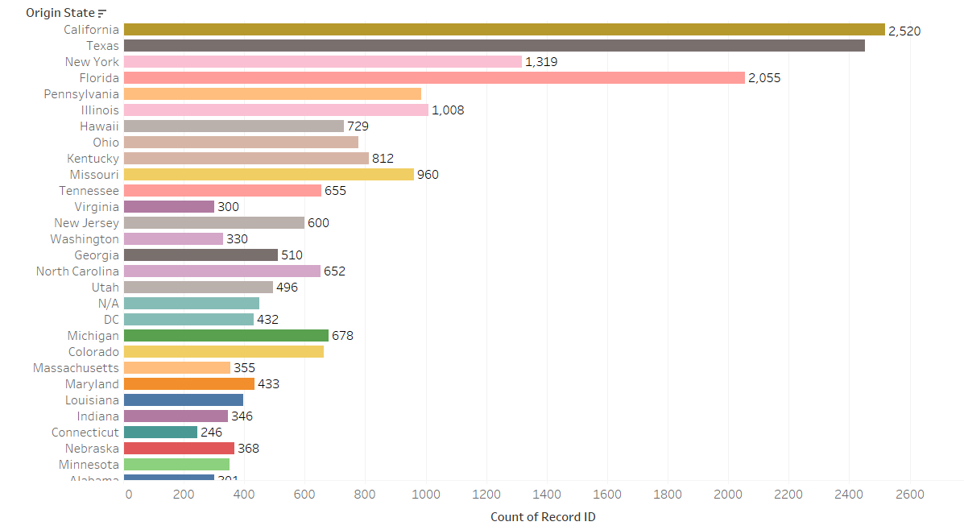
OPERATIONAL EFFICIENCY
Are there specific route or locations where the risk of bird strikes is higher.
INTERPRETATION: In the state of California the risk of bird strikes is higher with 2520.

Slide 12
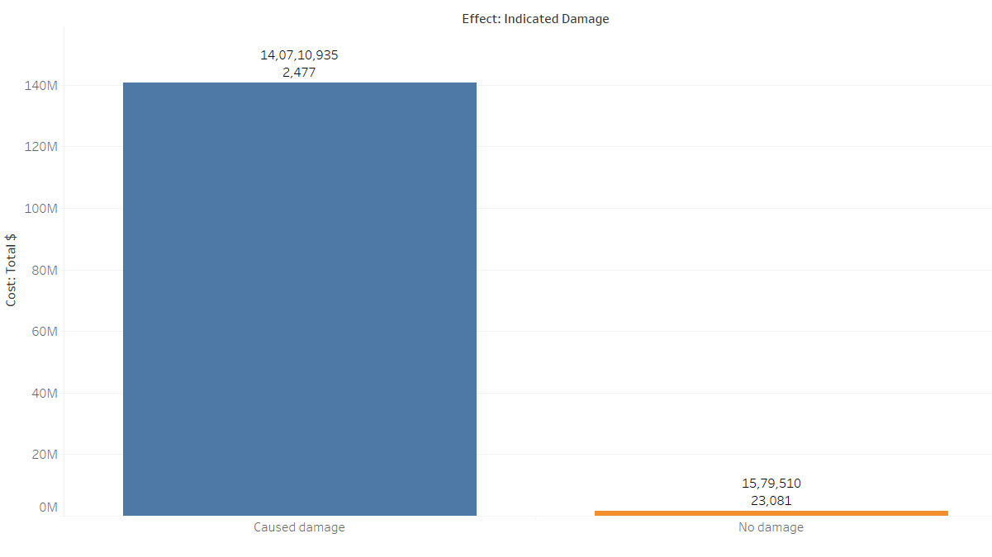
What is the total cost associated with wildlife strikes ,including damages and operational disruption.
INTERPREATTION: The total cost is 140710935 is associated with wildlife strikes.

Slide 13
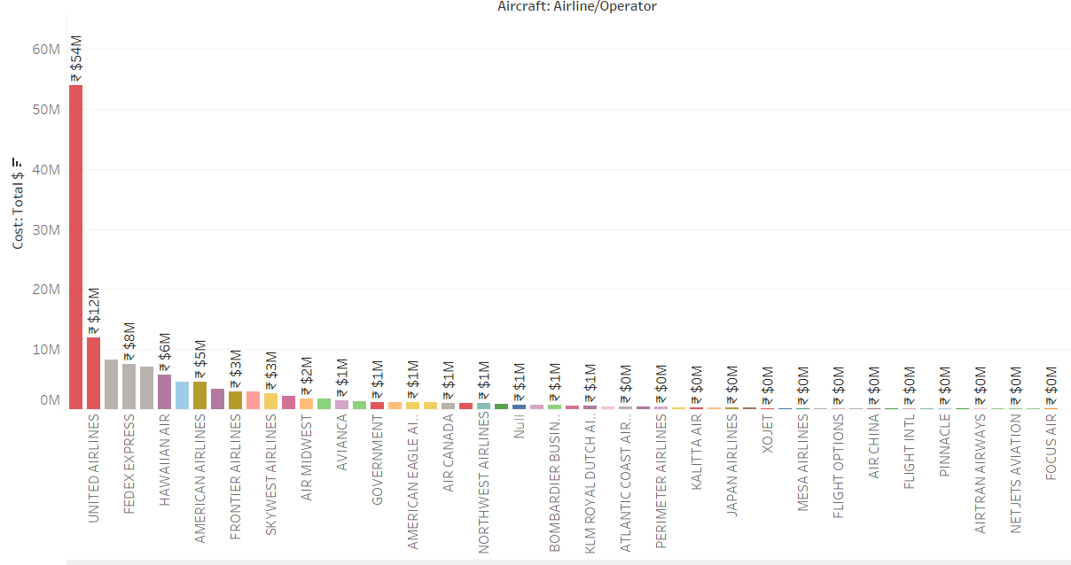
COST REDUCTION
What are cost faced by different airline
INTERPRETATION: The Business has highest cost with 54 million and followed by United airlines with the 12 million.

Slide 14
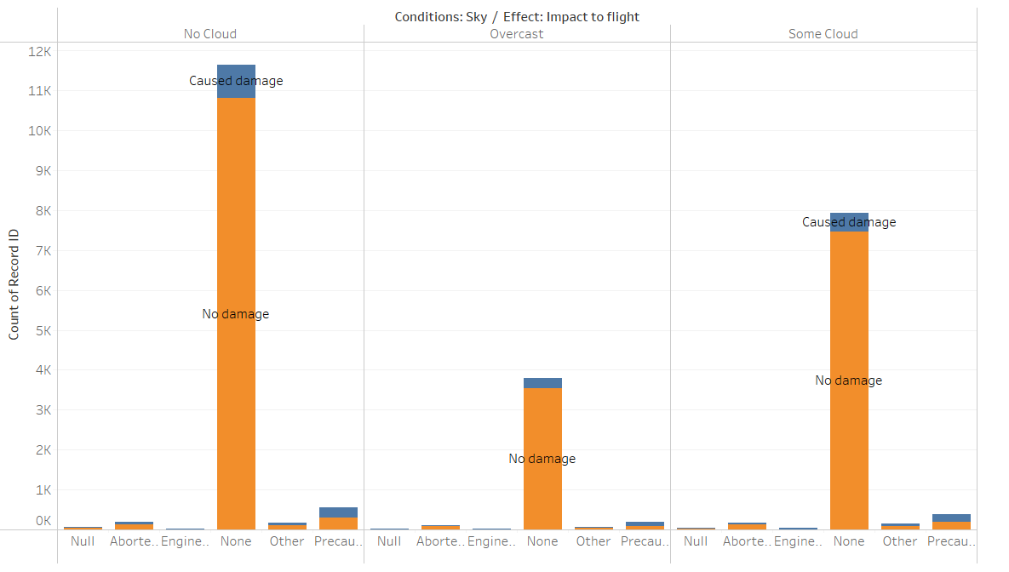
RISK MANAGEMENT
What are the risk factors contributing to the wildlife strikes , and how they can be migrated.
INTERPRETATION: The risk factors are sky conditions and Impact of flight and Indicated damage are the risk factors.And these are leads to the wildlife strikes

Slide 15
CONCLUSION:
From the project 1 the data set more focusing on the safety improvement and regulatory compliance and operational efficiency and cost reduction.
And the in the project 1 the unknown small bird has more bird strikes compared to other wildlife species . And also Approach phase of flight has more wildlife strikes . And also B-737-700 aircraft model has highest bird strikes . And Dallas Airport took highest strikes incidents. The more injuries were happened while precautionary landing.
From the project 2 the data set more focusing on the Operational efficiency and Cost Reduction and Risk Management.
The California state has highest risk bird strikes occurred and also the Business airline has highest cost with 54 million. The risk factors are sky conditions and Impact of flight and Indicated damage are the risk factors . And these are leads to the wildlife strikes

